Slide 1
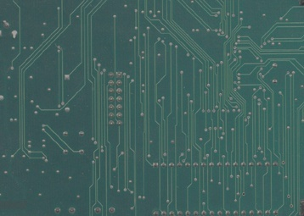
Operating Systems
Lecture#2
Types of interfaces,
Basic O.S concepts

Slide 2
Types of Interfaces Provided By Operating System

Slide 3
Types of interfaces between human and computer
Command Line Interface (CLI)
A CLI displays a prompt, the user types a command on the keyboard, the computer executes the command and provides textual output.
Graphical User Interface (GUI)
Uses windows, icons, menus and pointers
Natural Language Interface
Can range from simple command systems to voice activated text processing. Commands are spoken in “normal” language. Example C++ language to design programs.

Slide 4
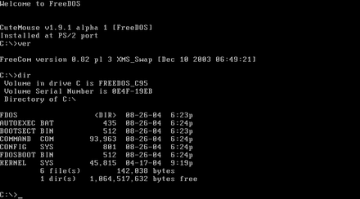
CLI Interface: DOS OS
Example of command line interface. (MS-DOS):Microsoft disk Operating system

Slide 5
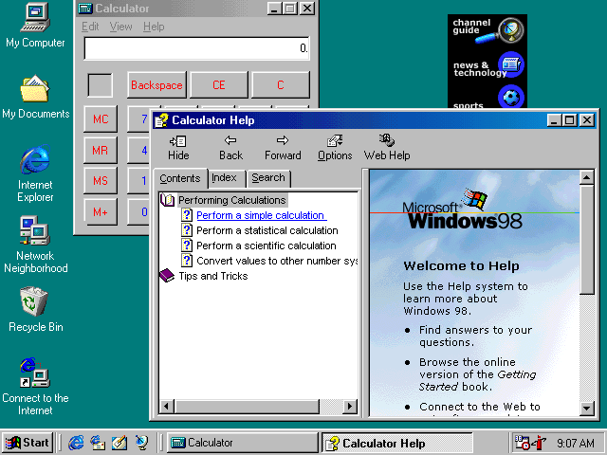
GUI(Graphical User Interface) Interface
Example of Graphical user interface(GUI), windows 98

Slide 6
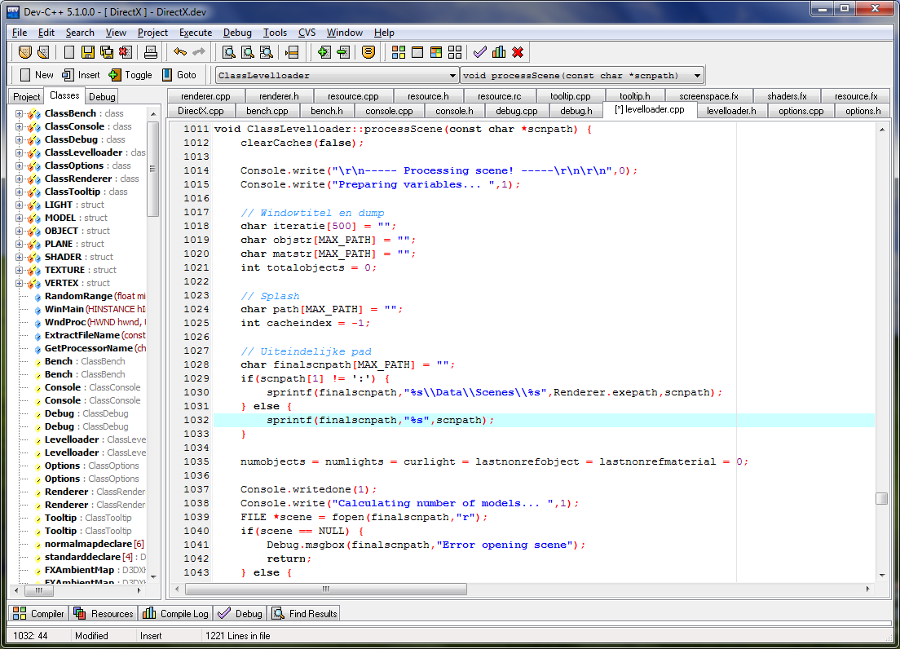
GUI(Graphical User Interface) Interface
Example of Language interface: C++

Slide 7
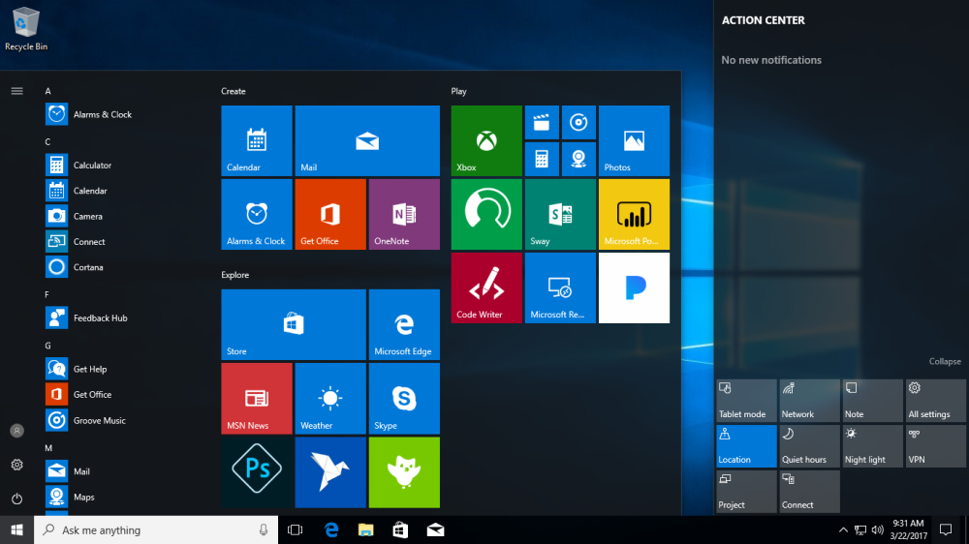
GUI(Graphical User Interface) Interface
Example of Graphical user interface(GUI), windows 10

Slide 8
Operating System Main Responsibilities and Concepts

Slide 9
Operating System Concepts
Processes
Deadlocks
Memory management
I/O Management
Files Management
Security Management

Slide 10
Process in Operating System

Slide 11
Process in Operating System
Definition: In computing, a process is an instance of a “computer program” that is being executed. It contains the program code and its current activity.
In object-oriented programming (OOP), an instance is a concrete occurrence of any object, existing usually during the runtime of a computer program.

Slide 12
Process in Operating System
Following are some reasons for creation of a process
User logs on.
User starts a program.
Operating systems creates process to provide service, e.g., to manage printer.
Some program starts another process, e.g., photoshop calls to display a picture.

Slide 13
Process in Operating System
A process is fundamentally a container that holds all the information needed to run a program.
Also associated with each process is a set of resources, commonly including registers, a list of open files, outstanding alarms, lists of related processes, and all other information needed to run the program.
Associated with each of these files is a pointer giving the current position (i.e., the number of the byte or record to be read next).
When a process is temporarily suspended, all these pointers must be saved so that a read call executed after the process is restarted will read the proper data.

Slide 14
Process in Operating System
In many operating systems, all the information about each process is stored in an operating system table called the process table.
The key process-management system calls are those dealing with the creation and termination of processes.
Consider a typical example. A process called the command interpreter or shell reads commands from a terminal. The user has just typed a command requesting that a program be compiled. The shell must now create a new process that will run the compiler. When that process has finished the compilation, it executes a system call to terminate itself.

Slide 15
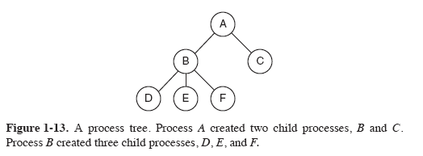
Process in Operating System
If a process can create one or more other processes (referred to as child processes) and these processes in turn can create child processes. For example, the Adobe Photoshop initiated another process to open an image.

Slide 16
Process Termination in Operating System
Normal Exit: Most processes terminates because they have done their job.
Error Exit: When process discovers an error. For example, a user tries to compile a program that does not exist.
Fatal Error: An error caused by process due to a bug in program for example dividing by zero.
Killed by another Process: A process executes a system call telling the Operating Systems to terminate some other process.

Slide 17
Deadlocks in Operating System

Slide 18
Deadlocks in Operating System
Definition: A deadlock is a situation in which two computer programs sharing the same resource are preventing each other from accessing the resource, resulting in both programs ceasing to function. It is called deadlock in operating system.
Everyone is waiting for an event, which will never occur.
For example, Taking soup at a party,

Slide 19
Deadlocks in Operating System
Computer systems are full of resources that can be used only by one process at a time. Common examples include printers, tape drives for backing up company data, and slots in the system’s internal tables.
Having two processes using the same file-system table slot invariably will lead to a corrupted file system.
Consequently, all operating systems have the ability to (temporarily) grant a process exclusive access to certain resources.

Slide 20
Deadlocks in Operating System
In a multiprogramming system, a number of processes competing for limited number of resources.
If a resource is not available at that instance then the process enters into waiting state.
If a process is unable to change its waiting state indefinitely because the resources required by it are held by other waiting process, then the system is said to be in deadlock state.

Slide 21
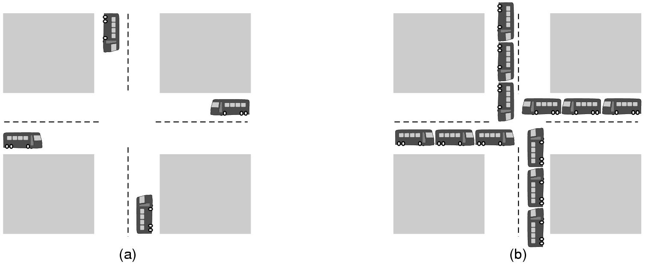
Deadlocks in Operating System

Slide 22

Deadlocks in Operating System: An example
Cars sharing same road(resource) cause traffic jam.

Slide 23
Deadlocks in Operating System
Any example related to computing?
Printing multiple documents at same time.
Deleting a document already in use.
Opening an image being edited (is it not created yet).

Slide 24
Memory management in Operating System

Slide 25
Memory management in Operating System
Definition: Memory management is the functionality of an operating system which handles or manages primary memory during execution.
Memory management in OS keeps track of each and every memory location, regardless of either it is allocated to some process or it is free.

Slide 26
Memory management in Operating System: Main Memory
Main Memory refers to a physical memory that is the internal memory to the computer. Main memory is also known as RAM.
Main memory holds the programs and instructions which are currently being executed by the CPU.
It is the fast access storage device.
It is read and write memory.
It is a volatile memory.

Slide 27
Memory management in Operating System: How it is managed
In a simple OS, only one program at a time is in the memory. To run a second program, the first one has to be removed and the second program placed in the memory.
Sophisticated OS allow multiple programs to be in the main memory at the same time.
To keep them away from interfering with one another, some kind of protection mechanism is needed.
Important memory related issue is managing the address space of the processes.

Slide 28
Memory management in Operating System: Address space
Address Space: Contains data, registers including program counter, stack pointer and all other information needed to run the program of the process.
A program counter is a register in a computer processor that contains the address (location) of the instruction being executed at the current time.
What if a process need more address space than the computer has main memory and the process wants to use it all?

Slide 29
Memory management in Operating System: Address space
A stack pointer is a small register that stores the address of the last program request in a stack.
A stack is a specialized buffer which stores data from the top down. As new requests come in, they "push down" the older ones.

Slide 30
Memory management in Operating System: Address space
What if a process need more address space than the computer has main memory and the process wants to use it all?

Slide 31
Memory management in Operating System: Virtual Memory
Technique called virtual memory exists, in which the OS keeps part of the address space in the main memory(RAM) and its some part on the disk(Hard disk) and moves pieces back and forth between them as needed.

Slide 32
I/O management in Operating System

Slide 33
I/O management in Operating System
An I/O management system in OS is responsible to take an I/O request from the user and send it to the physical device and then take whatever response comes back from the device and send it to the application.

Slide 34
I/O management in Operating System
I/O devices can be divided into two categories
Block devices − A block device is one with which the driver communicates by sending entire blocks of data. For example, Hard disks, USB cameras, etc.
Character devices − A character device is one with which the driver communicates by sending and receiving single characters (bytes, octets). For example, serial ports, parallel ports, sounds cards etc.

Slide 35
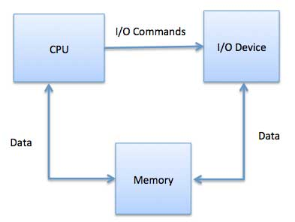
I/O management in Operating System

Slide 36
File management in Operating System

Slide 37
File management in Operating System
Definition: The system that an operating system or program uses to organize and keep track of files is called file management system of O.S.
For example, a hierarchical file system is one that uses directories to organize files into a tree structure.
Any examples?
Ext2, Ext3, Ext4, BtrFS, NTFS, FAT 32

Slide 38
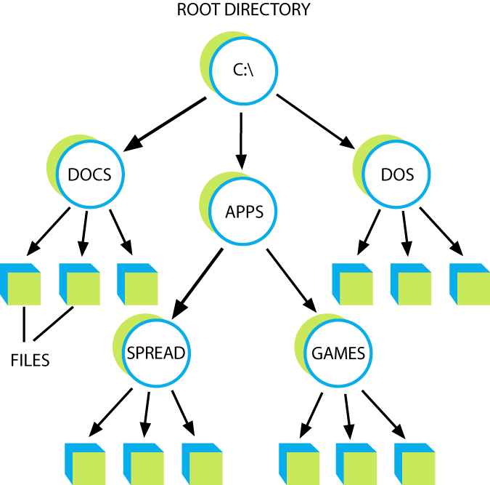
File management in Operating System: An example
For example opening a file in specific folder.
OS keeps and show the whole hierarchy.

Slide 39
Security Management in Operating System

Slide 40
Security Management in Operating System
Definition: Operating system security (OS security) is the process of ensuring OS integrity, confidentiality and availability.
OS security refers to specified steps or measures used to protect the OS from threats, viruses, worms, malware or remote hacker intrusions.
Both system and application software are available for this purpose.

Slide 41
Security Management in Operating System: Confidentiality
Measures undertaken to ensure confidentiality are designed to prevent sensitive information from reaching the wrong people, while making sure that the right people can in fact get it.
Access must be restricted to those authorized to view the data in question

Slide 42
Security Management in Operating System: Integrity
Integrity involves maintaining the consistency, accuracy, and trustworthiness of data over its entire life cycle. Data must not be changed in transit, and steps must be taken to ensure that data cannot be altered by unauthorized people.

Slide 43
Security Management in Operating System: Availability
Availability is best ensured by rigorously maintaining all hardware, performing hardware repairs immediately when needed and maintaining a correctly functioning operating system environment that is free of software conflicts.

Slide 44


